Slide 1
Faculty Senate
April 20, 2017
Dr. Robert J. Marley
Provost and Executive Vice Chancellor for Academic Affairs

Slide 2
UPDATES
Interim Chancellor
VP and Dean of CEC
Chair Searches

Slide 3
UPDATES Cont.
Budget Process
May 10 target for release of proposed reductions for FY18
April 4 letter from President Choi asked all campuses to identify 8-12% overall reduction going forward
Asked for consideration of program realignment, merger, elimination based on priorities and quality assessment
Goal of recommendations by end of calendar year 2017
Question: How can faculty be involved in the process?

Slide 4
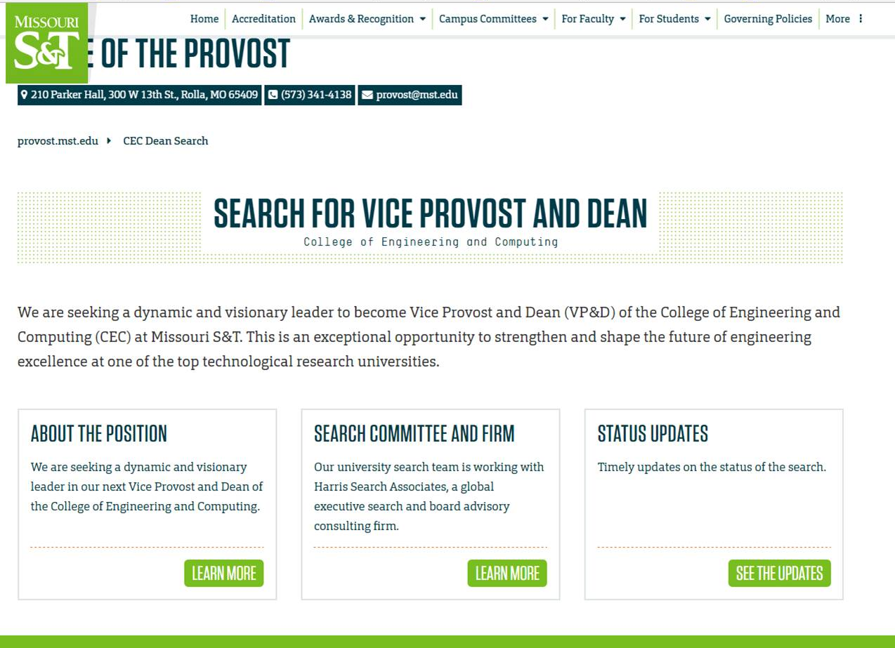

Slide 5
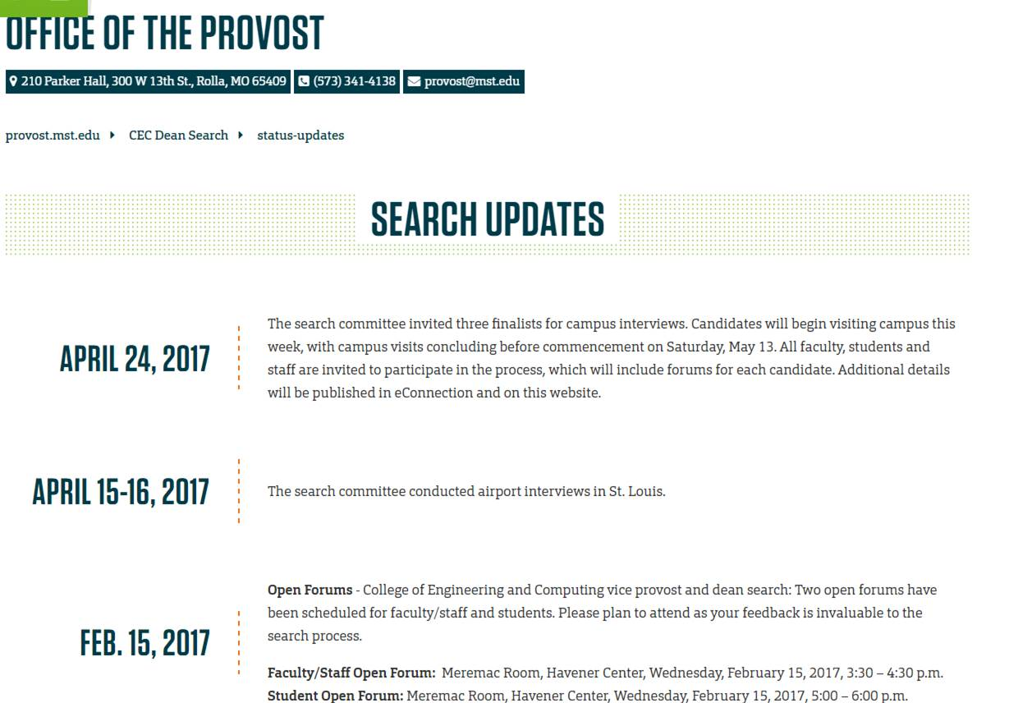

Slide 6
QUESTIONS?

Slide 7
Division Updates
Faculty Senate Meeting
Thursday, April 20, 2017

Slide 8
Enrollment Management
Spring 2017 Commencement is May 13 with ceremonies at 10:00 a.m. and 3:30 p.m. Graduate and undergraduate degrees will be presented at each ceremony, with roughly 600 degrees awarded in each ceremony.
Thanks to all faculty who helped with Open House on April 14. Over 240 students and their families attended.
Saturday, April 22 is the PRO Day

Slide 9
College of Arts, Sciences, and Business
Nicholas Leventis, Chariklia Sotiriou-Leventis, and Malik Saeed (Chemistry) have been issued US Patent Number 9,593,225 entitled, “Multifunctional Porous Aramids (Aerogels), Fabrication Thereof, and Catalytic Compositions Derived Therefrom.”
Nicholas Leventis and Chariklia Sotiriou-Leventis (Chemistry) have been issued US Patent Number 9,550,846 entitled, “Flexible to Rigid Nanoporous Polyurethane-Acrylate (PUAC) Type Materials for Structural and Thermal Insulation Applications.”
Yew San Hor (Physics) has received an additional $100,000 from NSF for his project entitled, “CAREER: Surface State Studies of Topological Insulators/superconductors” bringing the total award amount to $538,000.

Slide 10
College of Engineering and Computing
Dr. John Myers, professor in structural engineering, and Associate Dean for Academic Affairs in the College of Engineering and Computing, was named Outstanding Educator by the Architectural Engineering Institute.
Dr. Mary Reidmeyer, teaching professor of ceramic engineering and outreach coordinator in materials science and engineering at Missouri University of Science and Technology, has been named the recipient of the inaugural Dr. Elizabeth Cummins Women’s Advocate Award
Dr. Xiaoping Du, Curators’ Distinguished Teaching Professor of mechanical and aerospace engineering at Missouri University of Science and Technology, has won the 2017 Governor’s Award for Excellence in Teaching.
SMART LIVING SEED FUNDING (CEC and CASB faculty):
13 proposals received from 11 departments and 29 faculty members for interdisciplinary projects building capability for extramural funding.
Dr. Chenglin Wu, assistant professor of civil, architectural and environmental engineering, and Dr. Denise Baker, assistant professor of psychological science, received $33,000 seed funding for their proposal, “Human-Centered Origami and Kirigami Structures for Environmental Lighting.”
Dr. S.N. Balakrishnan, Curators’ Distinguished Professor of mechanical and aerospace engineering, and Dr. Devin Burns, assistant professor of psychological science, received $35,000 seed funding for their proposal, “Quantum Modeling of Decision Making in Smart Living.”
Another competition will run in the fall.

Slide 11
Office of Graduate Studies
Midwestern Association of Graduate Schools
Conference held April 4-7
Venkat Allada was Chair of MAGS for 2016-2017
S&T’s Three Minute Thesis (3MT) winner, Joshua Heck (MS in ME), participated in 3MT regional competition held at MAGS
Spring 2017 Doctoral Enrollment at an all-time high
647 doctoral students enrolled
101 Theses/Dissertations format checked SP 2017

Slide 12
Office of Sponsored Programs
Summary of FY17 activities year-to-date (February)
Number of funded proposals is up by 2% for a total of 191
Total dollars is $22M which is up by 2%
Number of new proposals submitted is up 10% for a total of 416
Total dollars is $107M which is down by 5%
Number of Research Board proposal submitted is down by 19% for a total of 22
Total dollars is $880K which is down by 35%
Number of active awards is up by 4% at 621
Total expenditures is $27M which is up by 5%
Net grant and contract expenditures is $20M which is up by 7%
F&A recovered is $3.5M which is up by 7%

